Slide 1
HOSPITALITY ANALYTICS
Final Business Intelligence Project
Excel • MySQL / SQL • Power BI • Tableau
Revenue | Bookings | Occupancy | Cancellations | Customer & Channel Analysis
Prepared for final project review / viva
Team Members :
Chandrakala T
Nivedita Sarnad
Ketan Jadav
Gowtham M
Rajveer Singh
Vedant Kannan

Slide 2
PROJECT TEAM & RESPONSIBILITIES
Collaborative ownership across data preparation, analytics, visualization and business insights
Vedant Kannan
Gowtham M
01
Project Coordinator
02
Data Analyst
Overall coordination & deadlines
Documentation & QA
Data understanding & data dictionary
Nivedita Sarnad
Chandrakala T
03
Data Cleaning Analyst
04
KPI Analyst
Cleaning & preparing dataset
KPI calculations & formulas
Ketan Jadhav
Rajveer Singh
05
Visualization Analyst
06
Business Insights Analyst
Charts & dashboard visuals
Findings & recommendations
Hospitality Analytics Dashboard | Team Structure

Slide 3
1. Objective & Business Problem
Turning raw hotel booking data into decision-ready management insights.
Business Problem
Project Objective
Hotel management needs a consolidated view of operational and financial performance. Raw booking records make it difficult to compare properties, cities, room categories, booking platforms and time periods.
Build a multi-tool analytics solution that measures revenue and bookings, compares occupancy, identifies revenue concentration, tracks trends, quantifies cancellation leakage and supports management decisions through dashboards.
• Measure overall booking and revenue performance.
• Compare occupancy across cities and properties.
• Understand revenue contribution by hotel, room category and booking platform.
• Track monthly movement and weekday/weekend performance.
• Measure cancellation rate, ratings and revenue loss.
• Translate analysis into actionable business recommendations.
Hospitality Analytics Dashboard | Final Project Presentation 2

Slide 4
2. Dataset & Data Model
Fact-and-dimension structure used consistently across the analytics workflow.
Table / Module | Role | Key fields / measures
fact_bookings | Booking-level fact | Booking ID, property, dates, guests, room, platform, rating, status, generated & realized revenue
fact_aggregated_bookings | Occupancy fact | Property, check-in date, room category, successful bookings, capacity
dim_hotels | Hotel dimension | Property ID, property name, category, city
dim_rooms | Room dimension | Room ID, room class
dim_date | Date dimension | Date, month label, week number, day type
Module 1 — Excel
Module 2 — SQL
Modules 3 & 4 — BI
Data preparation, PivotTables/PivotCharts, KPI cards and interactive dashboard layer.
Database validation, KPI calculations, joins, conditional aggregation, trends and hotel performance reporting.
Power BI and Tableau translate validated analysis into interactive visual decision-support views.
BOOKING RECORDS
OCCUPANCY RECORDS
REALIZED REVENUE
REVENUE LOSS
fact_bookings
aggregated fact
dataset total
generated − realized
134,590
9,200
₹170.88 Cr
₹29.88 Cr
Hospitality Analytics Dashboard | Final Project Presentation 3

Slide 5
3. Module 1 — Excel Analytics
The Excel layer establishes the analytical foundation and validates the business story.
What I did
Why Excel was useful
Key output
• Organized the fact and dimension data.
• Built PivotTables for hotel, city, room, platform and monthly analysis.
• Created KPI calculations for revenue, bookings, rating, cancellation rate and revenue loss.
• Built PivotCharts for categorical comparisons and monthly trends.
• Added slicers for City, Booking Platform and Booking Status.
• Created a dedicated presentation dashboard with KPI cards.
Excel provides a fast validation layer before BI publishing. PivotTables make it easy to test whether totals and rankings make business sense, while formula-driven KPI cards reduce manual reporting effort.
The Excel output becomes a benchmark for the SQL and BI versions of the same analysis.
A management-friendly analytical workbook covering:
1. Revenue performance
2. Booking volume
3. Occupancy
4. Hotel / city comparison
5. Room-class mix
6. Booking-channel mix
7. Monthly trend
8. Cancellation and revenue leakage
9. Interactive filtering
The dashboard is designed to answer “where is performance coming from and where is attention required?”
Hospitality Analytics Dashboard | Final Project Presentation 4

Slide 6
4. Module 3 — Power BI
Interactive reporting layer for management exploration and KPI monitoring.
Approach
Recommended visual structure
Business value
Import the validated dataset / analytical outputs, establish the data model, create measures, and build a management dashboard around the same KPI definitions.
The focus is not just visualization: filters and relationships allow users to move from a headline KPI to the underlying business dimension.
Top: KPI cards — revenue, bookings, occupancy, cancellation rate, realization / loss.
Middle: revenue by city / hotel and occupancy comparison.
Bottom: room-class contribution, platform performance and monthly trend.
Filters: City, Booking Status, Booking Platform, Property and time where implemented.
Power BI turns validated SQL/Excel calculations into an interactive decision-support layer.
Management can identify:
• high / low performing properties
• revenue concentration
• utilization differences
• cancellation leakage
• channel dependence
• trend changes
The BI layer should preserve the same KPI definitions used in validation.
Hospitality Analytics Dashboard | Final Project Presentation 6

Slide 7
5. Module 2 — SQL / MySQL Analytics
SQL converts the model into repeatable, testable and presentation-ready business metrics.
SQL workflow
Core SQL concepts
Business outputs
1. Create / select the hospitality_analytics database.
2. Validate tables using SHOW TABLES and DESCRIBE.
3. Validate row counts and booking IDs.
4. Calculate core KPIs.
5. Join fact tables to dimensions.
6. Group results by hotel, city, room, platform and time.
7. Use CASE WHEN for conditional metrics.
8. Use DATE_FORMAT / STR_TO_DATE for date analysis.
9. Use CTEs and LAG() for advanced weekly comparisons.
10. Produce a consolidated hotel performance report.
JOIN — combine facts with descriptive dimensions.
GROUP BY — aggregate KPIs by business dimension.
ORDER BY — rank performance.
CASE WHEN — conditional counting / aggregation.
NULLIF — protect ratio calculations.
ROUND — presentation-ready numbers.
CTE / WITH — readable multi-step logic.
LAG() — week-over-week movement.
Subqueries — align revenue and capacity before ratios.
• Revenue and booking totals
• Occupancy and capacity
• Cancellation / no-show analysis
• ADR and RevPAR
• Hotel / city / room performance
• Platform performance
• Weekday vs weekend
• Monthly revenue trend
• WoW KPI movement
• Complete hotel scorecard
SQL is the validation and analytical engine behind the dashboards.
Hospitality Analytics Dashboard | Final Project Presentation 5

Slide 8
6. Module 4 — Tableau
A second visualization layer to communicate the same analytical story through an interactive visual experience.
Analytical focus
Design principle
Outcome
Tableau can present the same validated measures with emphasis on visual exploration:
• Revenue and booking KPIs
• City / hotel comparison
• Occupancy
• Room-class mix
• Booking-channel performance
• Monthly / weekly trend
• Booking-status analysis
Use the visual form that matches the question:
• bars for categorical ranking
• lines for time trends
• KPI cards for headline metrics
• filters for slicing the same business measure
The objective is consistency across Excel, Power BI and Tableau—not three different versions of the truth.
Tableau provides an alternate stakeholder-facing view of the validated analytics.
A strong presentation should demonstrate:
1. What changed?
2. Where did it happen?
3. Which business dimension explains it?
4. What action should management take?
The screenshot on the later slide will be used to show the final Tableau dashboard.
Hospitality Analytics Dashboard | Final Project Presentation 7

Slide 9
7. Executive KPI Snapshot
Final benchmark values from the project dataset / validated analysis.
TOTAL BOOKINGS
REVENUE GENERATED
REVENUE REALIZED
REVENUE LOSS
134,590
₹200.75 Cr
₹170.88 Cr
₹29.88 Cr
booking records
potential / generated revenue
realized revenue
generated − realized
REALIZATION
CANCELLATION RATE
NO-SHOW RATE
AVERAGE RATING
85.12%
24.83%
5.02%
3.62 / 5
realized / generated
cancelled / total bookings
no-show / total bookings
customer rating
AVG. GUESTS / BOOKING
OVERALL OCCUPANCY
ADR
CANCELLED BOOKINGS
2.04
57.87%
₹12,696.12
33,420
guest count
successful bookings / capacity
current SQL definition
high-impact leakage segment
Hospitality Analytics Dashboard | Final Project Presentation 8

Slide 10
8. Key Analysis — Revenue, City & Property
What the data says about revenue concentration and operational performance.
City | Realized revenue | Interpretation
Mumbai | ₹66.86 Cr | Highest realized revenue
Bangalore | ₹42.04 Cr | Second-highest realized revenue
Hyderabad | ₹32.52 Cr | Mid-tier contribution
Delhi | ₹29.45 Cr | Lowest among four by realized revenue
Property-level finding
Atliq Exotica is identified in the project documentation as the highest-revenue hotel in the final transactional analysis, at approximately ₹37.47 Cr of generated revenue. This makes property-level benchmarking important for identifying repeatable operating practices.
Occupancy
Room mix
Monthly trend
Delhi has the highest city occupancy at 60.55%, while Bangalore is lowest at 55.77%. Revenue leadership and utilization leadership are therefore not identical.
Elite (RT2) is the highest room-category contributor at approximately ₹65.89 Cr generated revenue and ₹56.03 Cr realized revenue, followed by Premium (RT3).
May is the strongest month at approximately ₹68.39 Cr generated revenue; June is ₹65.19 Cr and July is ₹67.17 Cr. The dataset covers May–July 2022.
Hospitality Analytics Dashboard | Final Project Presentation 9

Slide 11
9. Key Analysis — Booking, Occupancy, Room & Channel
The operational story behind the revenue numbers.
Booking status | Bookings | Realization rate
Checked Out | 94,411 | 100%
Cancelled | 33,420 | 40%
No Show | 6,759 | 100%
Cancellation impact
Cancelled bookings account for 24.83% of all booking records. In the current SQL result, cancelled bookings generated about ₹49.80 Cr but realized only about ₹1.92 Cr. The gap is approximately ₹47.88 Cr within the cancelled segment.
This is the clearest revenue-leakage investigation area.
Channel
ADR
Weekday vs weekend
“Others” is the largest revenue-contributing booking-platform grouping in the project documentation, indicating dependence on a broad / less granular channel bucket.
Current SQL ADR result: ₹12,696.12. In this project definition, ADR is realized revenue divided by booking count; definitions should be standardized before production deployment.
The project includes day-type analysis using dim_date. This supports comparison of booking volume and revenue between weekday and weekend demand patterns.
Hospitality Analytics Dashboard | Final Project Presentation 10

Slide 12
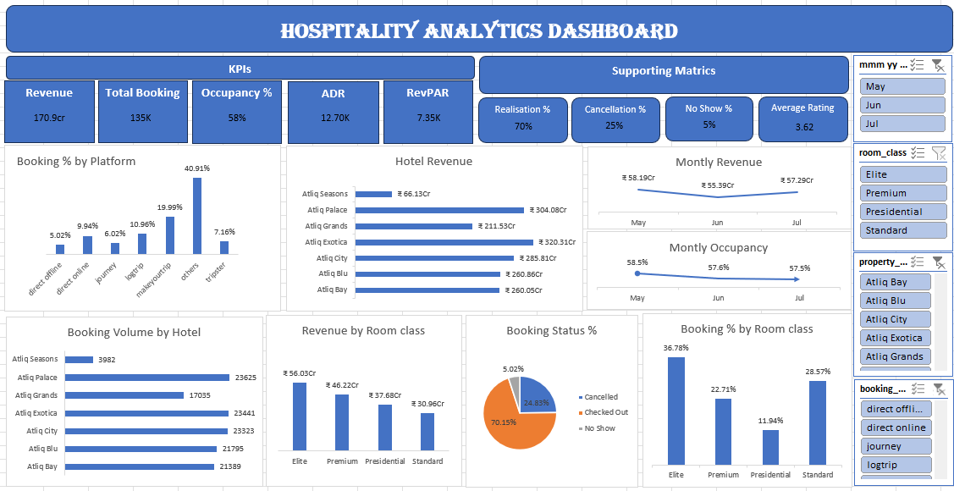
10. Dashboard Screenshot — Excel
Hospitality Analytics Dashboard | Final Project Presentation 11

Slide 13
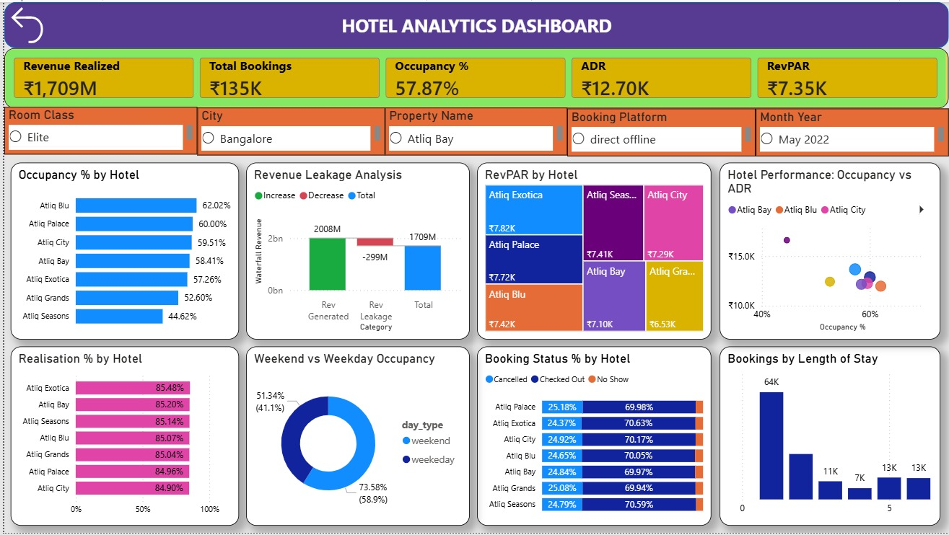
11. Dashboard Screenshot — Power BI
Hospitality Analytics Dashboard | Final Project Presentation 12

Slide 14
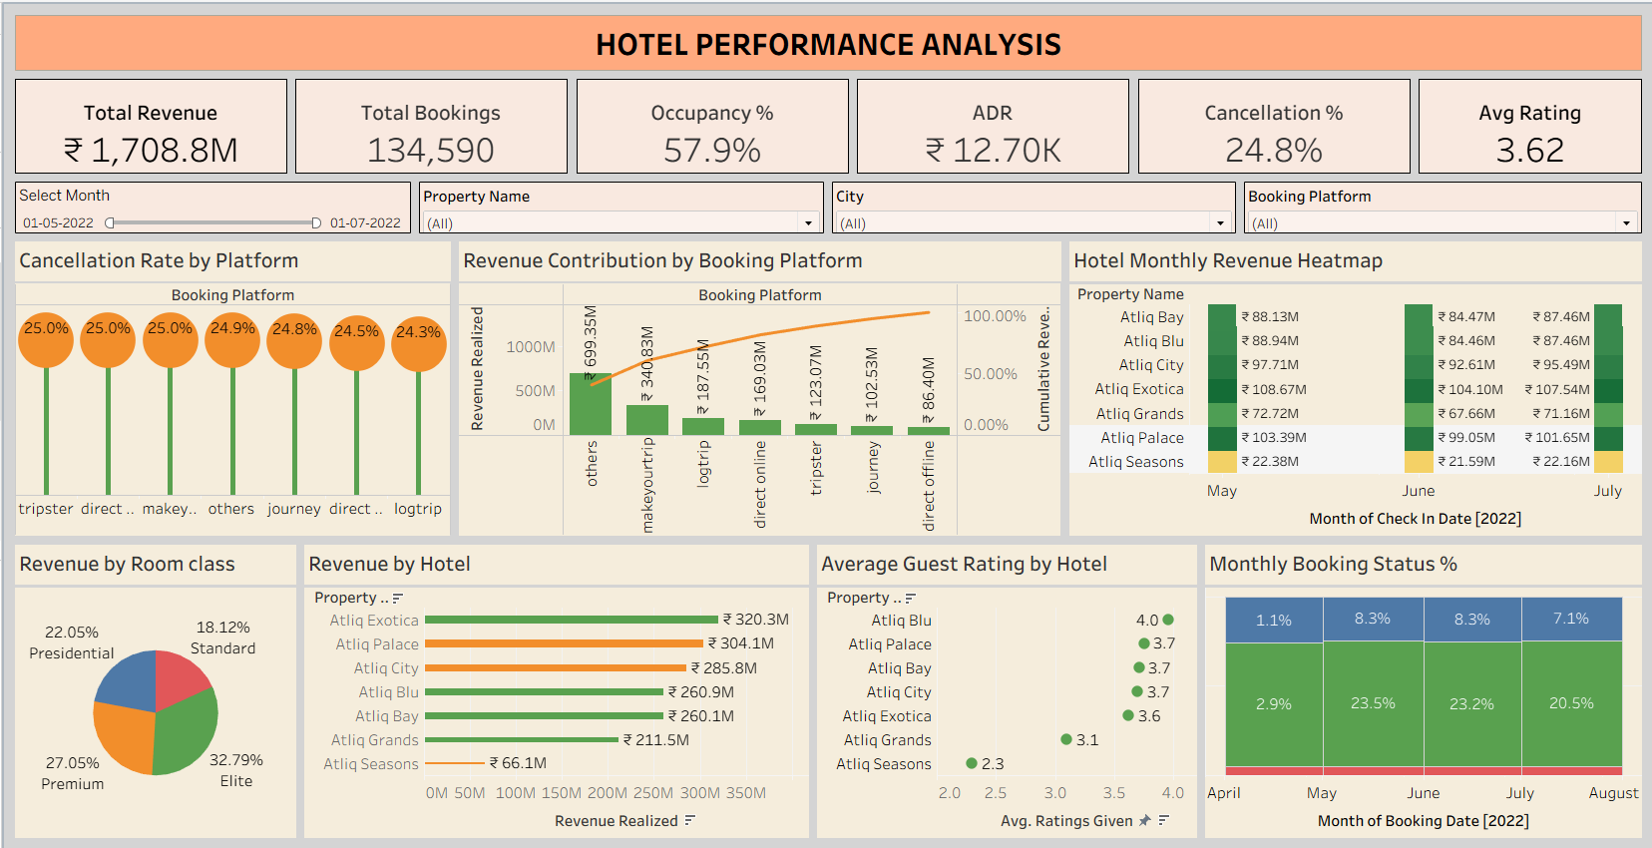
12. Dashboard Screenshot — Tableau
Hospitality Analytics Dashboard | Final Project Presentation 13

Slide 15
13. SQL Analytics Report — What Was Built
SQL was used as the repeatable analytical engine and validation layer.
Core KPI queries
Analysis / dashboard queries
Advanced SQL
Revenue — SUM(revenue_realized)
Bookings — COUNT(booking_id)
Capacity — SUM(capacity)
Successful bookings — SUM(successful_bookings)
Occupancy — successful bookings ÷ capacity × 100
Cancellation % — cancelled ÷ total bookings × 100
No-show % — no-shows ÷ total bookings × 100
ADR — revenue ÷ booking count
Realization % — realized revenue ÷ generated revenue
Hotel revenue
City revenue
Hotel category revenue
Revenue by room class
Revenue by booking platform
Cancellation by hotel
Occupancy by hotel / room class
Weekday vs weekend revenue
Monthly revenue
Top 5 hotels
Complete hotel performance report
JOIN — fact + dimensions
GROUP BY — business aggregation
CASE WHEN — conditional metrics
NULLIF — safe ratios
DATE_FORMAT / STR_TO_DATE — date handling
CTEs — readable intermediate calculations
LAG() — week-over-week comparisons
Subqueries — align revenue and capacity
The final hotel report combines booking and occupancy summaries into one management-friendly view.
Hospitality Analytics Dashboard | Final Project Presentation 14

Slide 16
14. Key Business Insights
The analysis converts the same hospitality dataset into a consistent business story across Excel, SQL, Power BI and Tableau.
1 Revenue concentration
2 Booking volume vs. value
3 Cancellation leakage
Mumbai is the strongest revenue-generating city, followed by Bangalore, Hyderabad and Delhi. Property-level revenue is also concentrated among a few leading properties.
The “Others” booking-platform bucket contributes the highest booking volume and revenue. Channel comparison should therefore consider revenue per booking, not volume alone.
33,420 bookings are cancelled. The analysis shows a clear gap between revenue generated and revenue realized for cancelled bookings, making cancellation control a direct revenue opportunity.
4 Room-category performance
5 Occupancy opportunity
6 Weekday demand strength
Elite generates the highest realized revenue among the room categories, followed by Premium, Presidential and Standard. This supports differentiated pricing and upselling strategies.
Overall occupancy is approximately 57.87%. The result indicates meaningful unused capacity and supports property-level demand management and targeted promotional actions.
Weekday bookings and revenue are materially higher than weekend performance. Staffing, pricing and promotional planning can therefore be aligned more closely with day-type demand.
Analysis benchmark | 134,590 bookings | ₹200.75 Cr generated | ₹170.88 Cr realized | 57.87% occupancy

Slide 17
15. Major KPI Recommendations
The analysis should lead to action, not only reporting.
Major KPI / Business Recommendations
REVENUE REALIZATION
CANCELLATION
1. Reduce cancellation leakage — 24.83% cancellation rate is the highest-impact operational issue; analyze property, platform and booking-window drivers.
2. Protect high-value channels — benchmark channel profitability, not only booking volume; improve visibility into the “others” bucket.
3. Improve low-utilization markets — compare occupancy and revenue together; investigate why Bangalore trails Delhi on occupancy.
4. Optimize room mix — Elite is the strongest room-category revenue contributor; use pricing and upsell strategies around high-value categories.
5. Standardize KPI definitions — especially ADR / RevPAR denominators before production deployment.
85.12%
24.83%
opportunity remains
priority issue
OCCUPANCY
REVENUE LOSS
57.87%
₹29.88 Cr
Final Verdict
utilization benchmark
management focus
The project successfully converts raw hospitality transactions into a structured decision-support solution across Excel, SQL, Power BI and Tableau.
The strongest management message is not simply “revenue is high”; it is that performance is concentrated by city / property / room / channel, while cancellations create a material gap between generated and realized revenue.
The next step is to operationalize the dashboard with standardized KPI definitions, dynamic capacity logic, deeper cancellation root-cause analysis and regular performance monitoring.
Hospitality Analytics Dashboard | Final Project Presentation 15

Slide 18
16. Final Verdict
A unified view of demand, revenue realization, channels, room mix and operational performance.
Overall business conclusion
Management priority
The business has strong booking demand and substantial revenue generation, but the analysis identifies a meaningful opportunity to improve revenue realization.
Protect realized revenue
01
02
Lift occupancy & utilization
The biggest priorities are to reduce cancellation leakage, improve channel-level visibility, increase utilization, and optimize room-category pricing. The same KPI definitions and validation checks should be retained across all reporting tools.
03
Optimize channel economics
04
Use KPI-driven review cycles
VERDICT: IMPROVE REALIZATION
Final takeaway | Demand is healthy; the next value lever is converting more bookings into realized, profitable revenue.

Slide 19
Thank You
Hospitality Analytics Dashboard | Final Project Presentation 12

